Slide 1
Q2
2013
2014
2015
2016
2017
2018
2019
2020
2021
2022
2023
2024
........
SQL Server
T-SQL (ETL)
T-SQL (QUERIES)
SSRS
SSIS
Power BI (Excel)
Tableau
Tableau
R
Shiny
Python
Data Forum Thoughts
Dash by Plotly
Lightkeeper
Benefits we will achieve by implementing this technology roadmap...
Speed (code base significantly lighter, cleaner, uniform, and easier to debug and evolve)
Scope (commissions, focus lists, performance, target price history, time-series / cross-sectional analysis, and fundamental research)
Quality (significantly less time spent on reconciliation, homogeneity between reporting systems, truly autonomous reporting, enhanced push / pull communication)
Auditability (standardization and documentation)

Slide 2
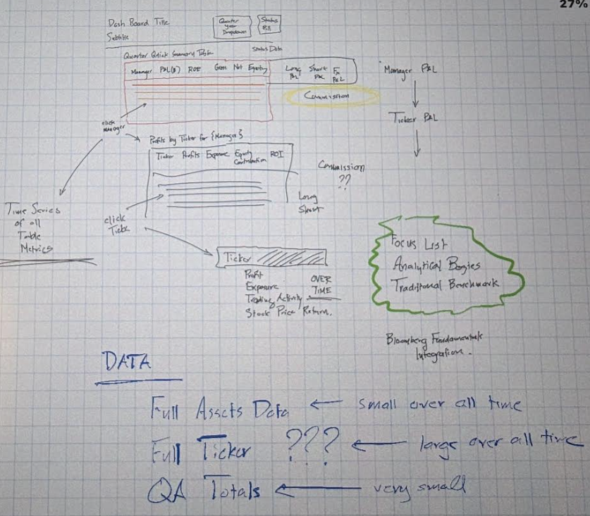
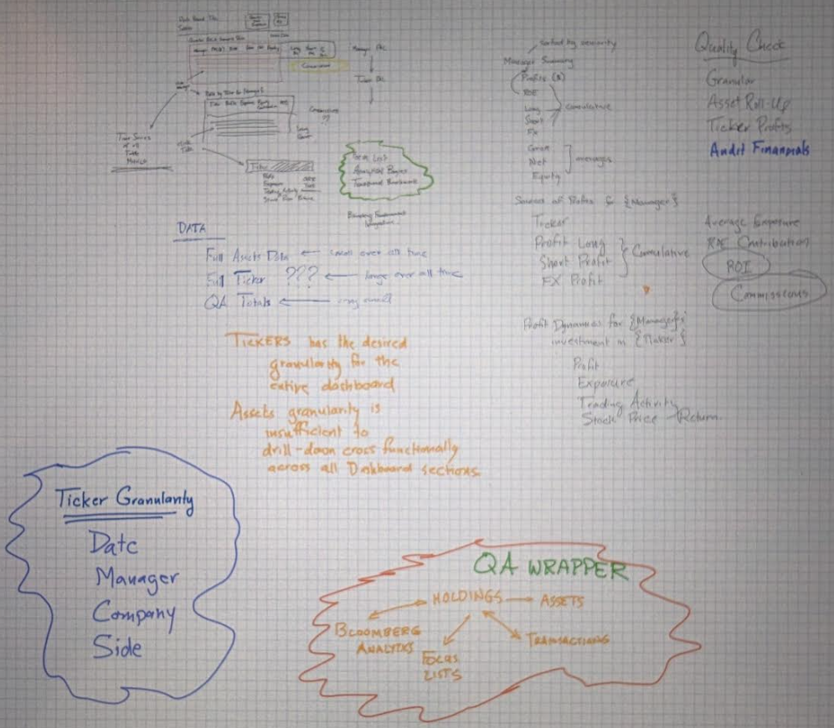
Train ride in yesterday...
Train ride out yesterday...

